Slide 1
uProcesoru sistēmu projektēšana un skaņošana
Piezīmes
2 lekcija - Basic Concepts

Slide 2
A Purpose of a Lection
Present basic concepts and issues while developing embedded Linux system.
Subjects introduced to give a better sense how entire system comes together.
Present types of hosts used for developing embedded Linux system.
Show details of the structure found in embed. Linux systems.
Present generic arch. of an embed. Linux systems.
Explain system startup, types of boot cfg., typical system memory layout.

Slide 3
Types of Hosts. Linux Workstation
Most common type of development host for embed. Linux systems.
It maybe a standard PC.
Variety of Linux distributions may be used for Host basis.
Any PC-based dev. platform has the following:
At least 1-2 GB of RAM. 4 GB are preferable;
At least 2 GHz CPU. More than two dual-core CPUs;
500 GB – 1 TB of HDD.

Slide 4
Types of Hosts. Unix and Windows Workstations
Unix Workstations:
Most of Linux related recommendations are also related to Unix/Unix-like systems.
Windows Workstation:
Cross-platform support needs binutils be compiled for Windows.
Usage of Cygwin environment for executing Linux utils.

Slide 5
Types of Host/Target Development Setups
Three different host/target architectures are available for the development of embedded Linux systems:
the linked setup,
the removable storage setup,
the standalone setup.

Slide 6
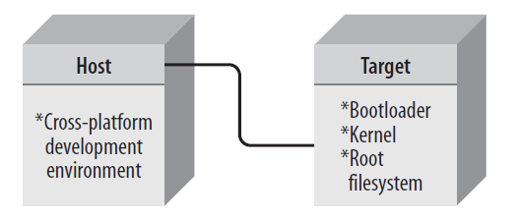
Linked Setup
Target and Host are permanently linked together – serial cable or Ethernet link. All transfers occur via link.
TFTP is used to transfer kernel from host to target.
Filesystem is NFS-mounted is used instead of being on storage media in the target.

Slide 7
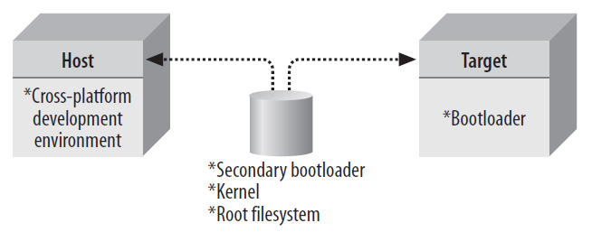
Removable Storage Setup
No direct link between host and target.
Storage device is written by the host.
Target contains a minimal bootloader, which loads other components from removable storage media.

Slide 8
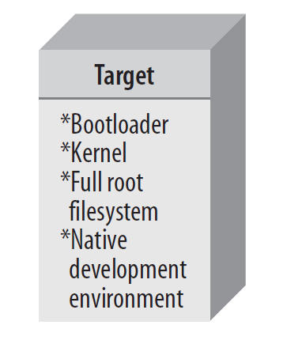
Standalone Setup
Here the target is self-contained development system.
Doesn’t require cross-platform dev. environment.
Doesn’t require any transfer between host and target.
The type is popular when building high-end PC-based embedded system (e.g. HAS).
Maybe freely expanded till mixed standalone/linked setup.

Slide 9
Types of Host/Target Debug Setups
Basically three types of debugging interfaces are used by designer:
Serial line:
the simplest way to debug (in all HW);
Some drawbacks: too slow; if embed. system have only one serial it is impossible to interact with system (via serial) and debug simultaneously.
Networking interface:
much higher bandwidth than serial;
many networking connections exist over the same phy. net. link;
uses net. protocol stack.
Special debugging HW:
direct hardware control over software: BDM or JTAG (rely on special functionality in the CPU);
connecting debugger to e.g. JTAG pins of the cpu the complete control of its behavior may be taken;
such kind of debuggers are used when new HW platform is designed.
debugger should be transparent with using GNU development toolchain (for instance gdb)

Slide 10
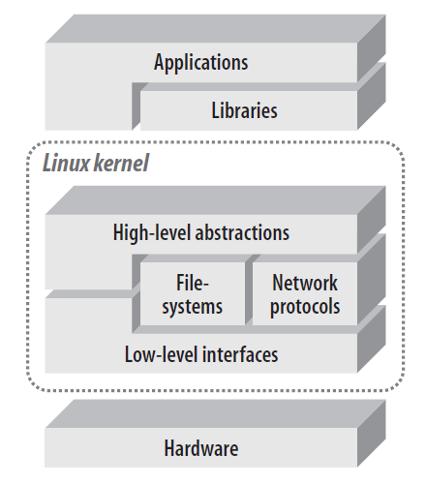
Generic Architecture of an Embedded Linux System
The architecture shown abstracts to a higher degree.
There is little difference between standard Linux and Embedded one.

Slide 11
Generic Architecture of an Embedded Linux System
Broad HW characteristics:
Linux normally requires at least 32-bit CPU containing MMU (uClinux does not).
A sufficient amount of RAM.
Minimal I/O capabilities are required for debugging.
The kernel must be able load a root file system of from a storage or from a network.

Slide 12
Generic Architecture of an Embedded Linux System
Linux kernel is the core component of the OS (1):
resides immediately above the HW;
manage a HW in coherent manner;
Linux drives the devices, manages I/O access, controls process scheduling, enforces memory sharing, handles distribution of the signals;
low-level interfaces:
are specific to HW on which kernel runs;
provide the direct control of HW resources using a HW-independent API. E.g. handling registers or memory page will be different for PowerPC and ARM, but will be accessible via common API.
Typically, these interfaces handle CPU-specific operations, arch.-specific memory operations and basic interfaces to devices.

Slide 13
Generic Architecture of an Embedded Linux System
Linux kernel is the core component of the OS (2):
higher-level interfaces:
provides abstractions to all systems, including processes, files, sockets and signals;
the code implementing the higher-level abstractions is almost constant regardless of the underlying architecture.
interpretation components – to understand and interact with structured data coming from or going to certain devices.
Filesytems tend to achieve file-level access using a special organization of the data on the disk where file and directory information is stored in a particular fashion so that it can be recognized when it is read again.
To accommodate existing filesystems as well as new ones, the kernel has a number of filesystem engines that can recognize a particular disk structure and retrieve or add files/directories.
The engines provide the same API to upper layers of the kernel through the Linux Virtual File System (VFS) abstraction. So the access is identical though there may be different lower-layer services.

Slide 14
Generic Architecture of an Embedded Linux System
Linux kernel is the core component of the OS (3):
filesytems continued:
In normal operation, kernel requires at least one filesystem – the root filesystem (RF);
from RF kernel loads first application to run;
also RF is used for loading modules an providing each process with a working directory – that might take place on other filesystems mounted within a tree, that begins with the RF.
applications, executed in Linux rely on libraries and special system daemons to provide familiar APIs and abstract services that interact with the kernel on the application’s behalf to obtain the desired functionality. For example library glibc – is used by most Linux applications.

Slide 15
System Startup
Three main SW components participate in system startup:
the bootloader:
is the first SW to run upon startup;
is highly dependent on the target’s HW;
performs low-level HW initialization;
after all jumps to the kernel startup code;
the kernel:
the early kernel startup code differs greatly between architectures;
conducts own init.;
after that jumps to the architecture-independent start_kernel() function:
initializes the high-level kernel functionality;
setups various callbacks into platform-specific code;
mounts the root filesystem;
starts the init process;
the init process:
continue with rest of the system startup;
is conducted in user space by the init program found on root filesystem.

Slide 16
Types of Boot Configuration
Type of boot configuration greatly influence:
the selection of bootloader;
its configuration;
type of SW and HW found on the host.
Any system built using CPU some form of solid-state storage device:
flash;
masked ROM.
The SW here is responsible for bootstraping the system (workstations, servers):
loading OS;
provide basic HW configuration options to the operator.
For Embedded Linux there are three bootstrap setups:
the solid-state storage media setup;
the disk setup;
the network setup.

Slide 17
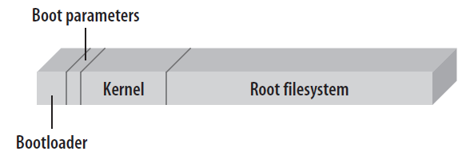
Solid-State Storage (SSS) Media Setup
SSS device holds initial bootloader, its configuration param., the kernel and the root filesystem.
Bootloader may be located at the bottom or at the top of addresses.
Some of parts may be included by another, e.g. boot param. may be contained within bootloader space.
Boot storage media initially programmed using a device programmer, e.g. JTAG.

Slide 18
Disk Setup
It is widespread solution for workstations and servers.
Here the kernel and the root filesystem are on disk device.
The initial bootloader either:
Loads a larger and more powerful secondary bootloader.
Fetches the kernel itself directly from the disk.
The setup is useful:
During development, when large number of kernels and root filesystems are used for testing.
If final device uses a hard disk.

Slide 19
Network Setup
Either root filesystem or both kernel and root filesystem are loaded via a network link.
In the first case, the kernel resides on solid-state storage media or a disk and root filesystem in mounted via NFS.
In the second case, only a bootloader resides on a local storage media. The kernel is downloaded via TFTP and root filesystem is mounted via NFS.
The setup is ideal:
Early development.
During debugging – enables the developer to share data and software rapidly between workstation and target.

Slide 20
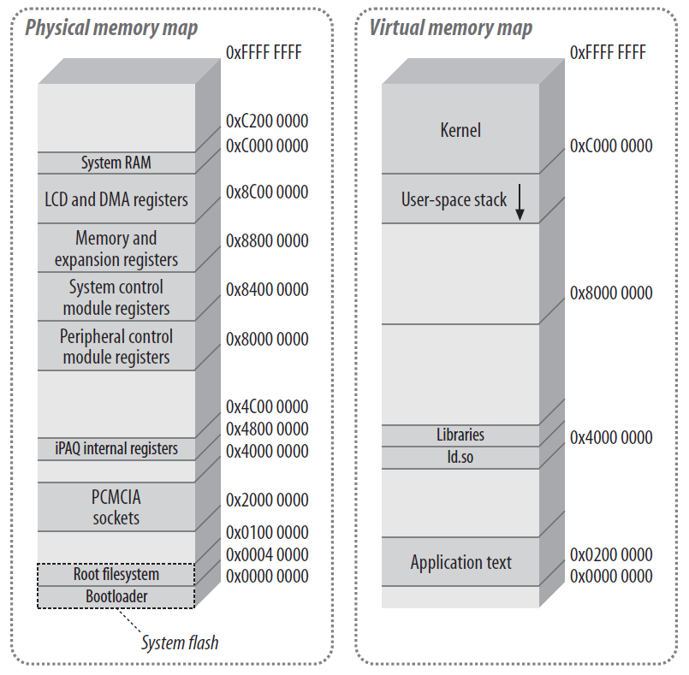
System Memory Layout
We will try to understand the system’s memory layout and the differences between physical and kernel’s virtual address spaces.
Physical map is important:
Provides with info on how to configure the kernel.
How to develop custom drivers.
Flash storage is divided in two:
Bootloader.
System’s root filesystem (in example is JFFS2). In the example, kernel is on the root filesystem.
Once Linux is running the programs use virtual addresses.
The kernel occupies a quarter of the virtual address space – known as kernel space.
The rest of the address space is occupied by application-specific text, data and library mappings – known as user space.

